Slide 1

Market Access Strategy and Forecast Weekly Check-In
November 10th, 2025

Slide 2
Agenda
Project Status
Preliminary Analog Research
Next Steps

Slide 3
Project Status

Slide 4
Project Dashboard – November 10th, 2025
 | Status Report
Items Completed | Review and synthesis of Neurizon materials received PMR (Primary Market Research) Screeners drafted: Physicians Payers
Partially Completed | PMR discussion guide and stimuli early drafts: Payers – Pending TPPs for completion Physicians – Pending TPPs for completion
Action Items | 11/03 | Neurizon to provide share TPP inputs and feedback on screening criteria
 | 11/07 | EVERSANA targeting to complete drafts of Payer / HCP DGs and stimuli
Upcoming Milestones | Finalize PMR materials and initiate the interviews Keep working on survey materials

Slide 5

Proposed Timeline
The project is expected to take approximately 12 weeks to complete. One extra week was added to accommodate potential holiday delays
Holiday
Key Milestone
Two milestones at risk with TPP delays
Key Meeting
Project Update
Activity | Week
 | 10/20 | 10/27 | 11/3 | 11/10 | 11/17 | 11/24 | 12/1 | 12/8 | 12/15 | 12/22 | 12/29 | 1/5 | 1/12
Landscape and Foundational Insights
Stakeholder Insights and Access Strategy
Commercial Forecasting for Target Markets
Project Management
Kick-off meeting
Secondary Research
Shape Initial Access Hypothesis
Prepare and align on research materials
Review interim findings
Deliver Final Report:
Market Opportunity Assessment
Kick-off primary research
Finish primary research
Review Interim Model and Forecasts
Deliver Final Model with Revenue Forecasts
JPM
We are here
Holiday Week

Slide 6
Research Material Alignment

Slide 7
Overview of Analogues (Non-Oncology)
All analogues were launched in or after 2023
Analogues | Indication | Annual WAC | US prevalence | Criteria for analogue selection
 |  |  |  | Adult population only | Prevalence 20-80k | Median survival 2-5 years¹ | Pharmacy benefit | Disease modifying | Chronic (>1 yr treatment) | # of criteria met
ATTRuby (acoramidis) | ATTR-CM (cardiac amyloidosis) | $244k | 55k | ✔ | ✔ | ✔ | ✔ | ✔ | ✔ | 6
Ojjaara (momelotinib) | Myelofibrosis + anemia | $346k | 25k | ✔ | ✔ | ✔ | ✔ | ✔ | ✔ | 6
Zilbrysq (zilucoplan) | Generalized myasthenia gravis | $569k | 20k | ✔ | ✔ |  | ✔ | ✔ | ✔ | 5
Filspari (sparsentan) | IgA nephropathy (proteinuria) | $149k | 50k | ✔ | ✔ |  | ✔ | ✔ | ✔ | 5
Iqirvo (elafibranor) | Primary biliary cholangitis (PBC) | $138k | 42k | ✔ | ✔ |  | ✔ | ✔ | ✔ | 5
Livdelzi (seladelpar) | Primary biliary cholangitis (PBC) | $151k | 42k | ✔ | ✔ |  | ✔ | ✔ | ✔ | 5
Vanrafia (atrasentan) | IgA nephropathy | $160k | 30k | ✔ | ✔ |  | ✔ | ✔ | ✔ | 5
Joenja (leniolisib) | Activated PI3Kδ syndrome | $594k | 500 | ✔ |  |  | ✔ | ✔ | ✔ | 4
Alyftrek (vanzacaftor / tezacaftor / deutivacaftor) | Cystic fibrosis | $369k | 34k |  | ✔ |  | ✔ | ✔ | ✔ | 4
Ctexli (chenodiol) | CTX (cholestanol disorder) | $436k | 400 | ✔ |  |  | ✔ | ✔ | ✔ | 4
Prioritized for deep-dive
1. ATTRuby: Median OS 2-5 years depending on disease stage. Source: Naoto et al., Journal of the American Heart Association, 2024. Ojjaara: Median OS 2.1 years. Source: Green et al., MPN Hub, 2025. Zilbrysq: 86% survival at 5 years, 79% at 10 years. Source: Khateb et al., Frontiers in Neurology, 2025. Ctexli: Median OS > 5 years. Source: Nie et al., Orphanet J Rare Disease, 2014. Filspari, Vanrafia: Median kidney failure-free survival > 5 years. Source: McGrogan et al., Nephrol Dial Transplant., 2011. Iqirvo, Livdelzi: Median OS > 5 years. Source: Green et al., The Pharmaceutical Journal, 2023. Joenja: Median OS > 5 years. Source: Mahendran et al., Orphanet J Rare Disease, 2025. Alyftrek: Median OS > 5 years. Source: CF Foundation Patient Registry, 2025

Slide 8
Overview of Analogues (Oncology)
All analogues were launched in or after 2023
Analogues | Indication | Annual WAC | US prevalence | Criteria for analogue selection
 |  |  |  | Adult population only | Prevalence 20-80k | Median survival 2-5 years¹ | Pharmacy benefit | Disease modifying | Chronic (>1 yr treatment) | # of criteria met
Inqovi (decitabine /cedazuridine) | MDS / CMML | $113k | 60k | ✔ | ✔ | ✔ | ✔ | ✔ | ✔ | 6
Fruzaqla (fruquintinib) | Colorectal cancer | $343k | 25k | ✔ | ✔ |  | ✔ | ✔ | ✔ | 5
Orserdu (elacestrant) | Breast cancer | $297k | 20k | ✔ | ✔ |  | ✔ | ✔ | ✔ | 5
Ibtrozi (taletrectinib) | Non‑small cell lung cancer | $354k | 10k | ✔ |  | ✔ | ✔ | ✔ | ✔ | 5
Augtyro (repotrectinib) | Non-small cell lung cancer | $367k | 4k | ✔ |  | ✔ | ✔ | ✔ | ✔ | 5
Elrexfio (elranatamab-bcmm) | Multiple myeloma | $580k | 36k | ✔ | ✔ |  |  | ✔ | ✔ | 4
Talvey (talquetamab-tgvs) | Multiple myeloma | $440k | 36k | ✔ | ✔ |  |  | ✔ | ✔ | 4
Gomekli (mirdametinib) | Neurofibromatosis type 1 | $360k | 30k |  | ✔ |  | ✔ | ✔ | ✔ | 4
Krazati (adagrasib) | Non-small cell lung cancer | $271k | 14k | ✔ |  |  | ✔ | ✔ | ✔ | 4
Jaypirca (pirtobrutinib) | Mantle cell lymphoma | $277k | 12k | ✔ |  |  | ✔ | ✔ | ✔ | 4
Prioritized for deep-dive
1. Fruzaqla: Median OS = 4.8 months for comparator arm of Fruzaqla’s Phase 3 trial. Orserdu: Median OS = 15 months for comparator arm of Orserdu’s Phase 3 trial. Ibtrozi: Median OS = 4.4 years for crizotinib. Source: Topal et al., Medicina Kaunas, 2025. Augtyro: Between 2 and 4.4 years, depending on patient population. Source: Topal et al., Medicina Kaunas, 2025, Zhong et al., Journal of Comparative Effectiveness Research, 2024. Inqovi: Median OS 24 months. Source: AZA-001 trial for azacitidine. Elrexfio, Talvey: Median OS = 13.8 months (LocoMMotion trial). Gomekli: Median survival > 5 years. Source: Evans et. al., European Journal of Juman Genetics, 2011. Krazati: Median OS = 11.3 months (CodeBreaK 200 trial). Jaypirca: Median OS between 6 and 10 months (source: Burkart et. Al., J Pers Med, 2022)

Slide 9
U.S. Disease Prevalence vs Annualized 2024 WAC
We observed a correlation between price and prevalence, particularly in non-oncology analogues.
Non-oncology analogues
Oncology analogues
Annual WAC
Annual WAC
US prevalence
US prevalence
Note: Price and prevalence are only two dimensions that do not account for other factors such as competition, unmet need, the product profile, etc.

Slide 10
Next Steps

Slide 11

Next Steps
Provide TPP inputs including quantitative efficacy & safety
Review PMR Interview screeners and provide feedback
Provide patient contact information and HCP/KOL lists
Continue progressing secondary research
Continue progressing discussion guideline and interview stimuli
Continue progressing survey questionnaire
Files Received
REDACTED_250716_Reg-Meeting_V0.1.pptx
EVERSANA_NUZ001 10-year Revenue Forecast Model 2025 Feb 16.xlsx
Expanded_KOL_HEALEY_table.xlsx

Slide 13
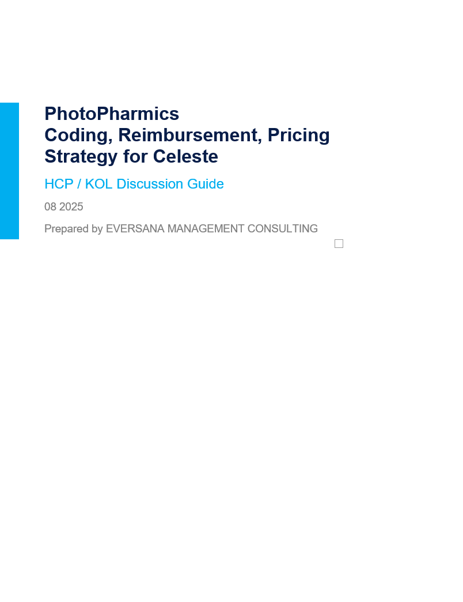
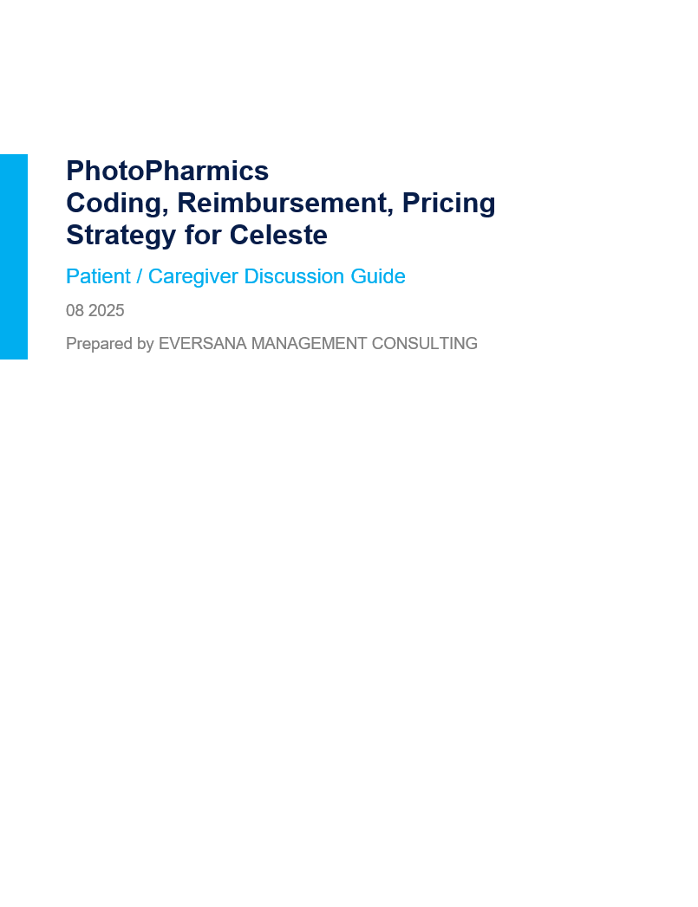

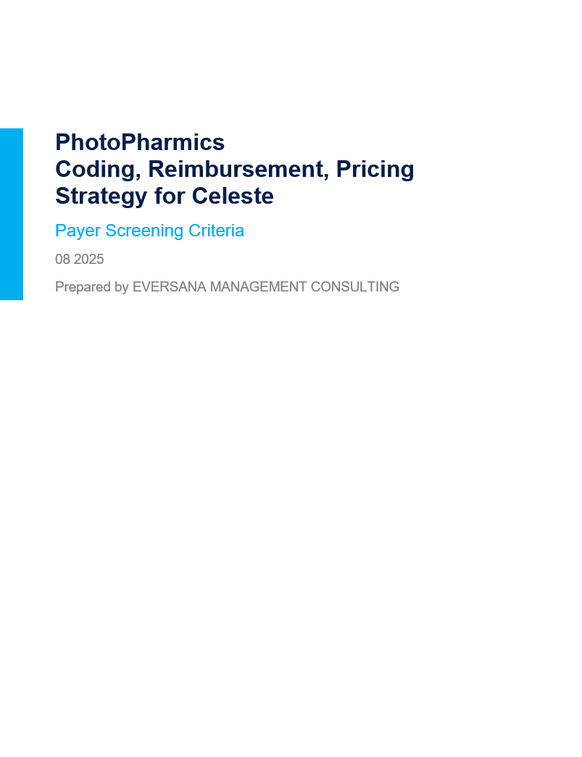

Project Discussion Primary Market Research Interview Materials
EVERSANA will leverage research materials for the primary research. These materials will be reviewed and revised in coordination with the Neurizon team.
Stakeholder | Screeners | Discussion Guides | Stimuli
HCPs / KOLs | Ready for review* | In progress, pending on TPP | In progress, pending on TPP
Payers | Ready for review | In progress, pending on TPP | In progress, pending on TPP
Patients / Caregivers | Ready for review | Planned | Planned
*EVERSANA can target specific KOLs as an alternative to screening questions

Slide 14
Project Discussion Primary Market Research Survey Materials
EVERSANA will leverage research materials for the primary research. These materials will be reviewed and revised in coordination with the Neurizon team.
Stakeholder | Survey Questions
HCPs / KOLs | Planned
Patients / Caregivers | Planned

Slide 15
Background and Situation Background and Business Need
Background
Business Need
Neurizon Therapeutics is a clinical-stage biotech company dedicated to developing treatments for neurodegenerative diseases, including Amyotrophic Lateral Sclerosis (ALS).
Their lead product, NUZ-001, operates by inhibiting the aggregation of TAR DNA-binding protein 43 (TDP-43)
Positive outcomes from Neurizon’s Phase 1 MEND study in slowing respiratory decline (SVC) in ALS have bolstered confidence in NUZ-001's therapeutic capabilities.
Accelerated approval is possible based on Phase 2 data (HEALEY-ALS platform trial)
There is a very significant unmet need in ALS as current disease modifying treatment options are limited:
Riluzole (generic availability)
Radicava (edaravone), FDA approved May 2017 (ORS May 2022)
Radicava $1,139.48 USD for 2 vial 100mL | 30 mg (1 dose)
Year 1: $153,830 | Year 2: $149,272
Radicava ORS $12,634.18 USD for 50mL | 1,050mg (10 dose)
Year 1: $170,561 | Year 2: $165,508
Relyvrio, initially FDA approved September 2022 but removed in April 2024 due to negative Phase 3 results
Neurizon is developing the global market access strategy for NUZ-001 and has partnered with EVERSANA to support the following initiatives that will provide insights for the US forecast model and beyond:
Landscape / Foundational Insights
Gap analysis of burden of disease / unmet need
Analogue assessment
Competitive scenarios at launch
Likely data scenarios for testing
US Payer, Provider and Patient Stakeholder Insights
Stakeholder reaction to NUZ-001 TPPs
Opportunities and drivers
Comparators and price potential
Opportunities to enhance the value proposition for payers
Opportunities to enhance price potential, reimbursement, access and uptake
Forecast Model based on scenarios and research-informed inputs
Global Access Insights
Considerations on how the model would need to be adapted for key regions (EU4, UK, Australia, Japan)
Go-to-Market Models
Top-level cost and requirements of different go-to-market models (e.g., Neurizon go alone including various vendor partnership options, big pharma acquisition)
Investor Deck Support
Notes:
NAVLIN
Radicava $1,139.48USD WAC (infusion 2vial 100mL 30mg) = 1 dose (60mg administered as an IV over 60min)
Radicava ORS $12,634.18USD (1 bottle 50mL 1,050mg) = 10 doses (105mg (5mL) in the AM)
Radicava ORS $17,687.85USD (1 bottle 70mL 1,470mg)
https://www.radicava.com/pdfs/radicava-prescribing-information.pdf
Daily dosing initial 14 days (14 days off)
Subsequent: 10/14 days on followed by 14 days off
In a 52 week period = 130 doses per yr (not including initial)

Slide 16



Background and Business Need Key Business Questions (1 of 2)
Non-Comprehensive
EVERSANA can work with Neurizon to address the following essential topics.
Current Treatment Landscape
What is the current treatment paradigm for ALS in the US? What have been opportunities and barriers to market access?
What are the key challenges or unmet needs that current treatments fail to address?
What are the biggest challenges patients face in accessing or adhering to current therapies (e.g., cost, logistics, side effects, availability of specialists)?
What pipeline products are most likely to be competitors to NUZ-001 at launch (e.g., NP-001, CNM-Au8, PrimeC)? How might the treatment paradigm evolve in the near future?
Product Value Perception
What degree of improvement is clinically meaningful and across which metrics? QoL?
How do physicians feel about the clinical profile for NUZ-001 vs. SOC?
Are there any concerns with the study design or gaps in evidence provided which payers and KOLs would need to see addressed?
Where would NUZ-001 fit into the clinical care pathway? (e.g., patient stage of progression, clinical presentation, age)?
What stage will NUZ-001 have the greatest impact? Does the amount of improvement in the endpoints (or stakeholder perception of value) vary in impact based on stage of disease?
How does an oral, potentially long-term therapy like NUZ-001 compare to existing options in terms of perceived balance between effectiveness, safety, convenience, affordability, and willingness to use?
How might NUZ-001 differentiate itself from other treatment options – clinically, economically, etc.?

Slide 17


Background and Business Need Key Business Questions (2 of 2)
Non-Comprehensive
EVERSANA can work with Neurizon to address the following essential topics.
Pricing Potential
Which analogues will be used by payers to benchmark price?
How will payers view NUZ-001 relative to Radicava, Riluzole and other therapies? What are implications for net price expectations?
What are the potential access scenarios given different price ranges, and how do they impact the forecast for NUZ-001?
What is the optimal launch price range for NUZ-001?
What rebate and discount ranges would be expected in the US? How would rebates and discounts impact market access and physician uptake?
What is patient price sensitivity for NUZ-001? Does this vary by patient type?
Access, Volume and Uptake
How will HCPs respond to the entry of a novel option for ALS?
What are the key barriers and drivers that will influence prescribing of NUZ-001?
What potential access challenges might NUZ-001 face, and how can they be resolved?
How will pricing and utilization management such as step edits, prior authorization and payer hurdles, impact physician uptake of NUZ-001?
What evidence would support the inclusion of NUZ-001 into the guidelines for the treatment of ALS, and how might that influence prescribing? Payer coverage and access?
How will patient advocacy groups influence NUZ-001 market potential?
What factors most influence patients’ willingness to start a new ALS therapy (e.g., physician recommendation, strength of clinical data, coverage certainty)?

Slide 18
Project Approach Project Phases Overview
1
US Landscape and Foundational Insights
2
Stakeholder Insights and Access Strategy
3
Commercial Forecasting
for Target Markets
Kick off project with Neurizon team Revisit the prior review of the existing forecast model and align on specific areas for attention Assess available data and review TPP deck Brainstorm on points of differentiation and hypotheses on reimbursement Align on key business questions (KBQs) Align on research sample Conduct secondary research to highlight: Competitors and analogue assessment Current pricing and reimbursement of competitors and analogues Gap analysis of unmet need Clinical program gaps and considerations Relevant reimbursement process and timelines Conduct claims analysis for market sizing and payer mix (optional) Develop primary research materials in collaboration with Neurizon team Screeners Discussion Guides TPP (i.e., data / clinical launch scenarios) Competitive launch scenarios Hold periodic check-ins with Neurizon team to present ongoing findings and discuss strategies | Conduct primary market research with US payers to: Understand perspectives on potential pricing, reimbursement Gather reactions to NUZ-001 value proposition Conduct primary market research with relevant US KOLS (i.e., providers) to: Confirm current perception of standard of care and unmet needs Test clinical profile of NUZ-001 Determine levels of provider adoption given pricing & access considerations Conduct online survey with prescribers to: Gather more robust feedback on value perception, physician prescribing, and impact of pricing and access considerations with likely future prescribers and relevant treaters Adds quantitative rigor to key inputs for forecasting exercise Conduct primary market research with patients/caregivers to: Test clinical profile of NUZ-001 Determine levels of patient adoption given clinical profile and out of pocket (OOP) cost Conduct online survey with patients to: Gather more robust feedback on product profile, adoption, and OOP considerations Synthesize insights from secondary and primary market research Value proposition perceptions Comparator and price range Expected utilization vs. competitors Recommendations for evidence generation to support reimbursement and access and pricing | Input findings from all previous research to inform key forecast assumptions Build forecast funnel and dashboard Develop robust US forecast, leveraging market insights from key stakeholders and secondary research findings: Define and size the market opportunity (TAM/SAM) Market share over time (SOM) Anticipated pricing corridors Outline top-level go-to-market options and assessment including resource needs and cost elements, such as field force size and expenses Build baseline working model with input variables to determine potential revenue potential Review forecast with Neurizon team Develop final report with recommendations, including modular outputs in format ready to support future board and investor communications (forecast visuals, pricing tables and summary insights) Outline considerations on how the model would need to be adapted for EU4+UK, Australia and Japan

Slide 19
Detailed Project Approach: US Landscape and Foundational Insights Align on Key Business Questions
We will conduct secondary research and connect with the Neurizon team to shape our initial hypotheses for research.
Inputs
Outputs
Collect and Review Previous Research Materials
Confirm key business questions and project objectives with all stakeholders
Review existing market research and resources
Information gaps to be addressed during primary research
Outstanding questions and hypotheses that will inform discussion guide / survey development
Perform Additional Secondary Research
Unmet needs in ALS diagnosis
Reimbursement in the US
Reimbursement considerations for EU4, UK, Japan
Opportunities and risks
EVERSANA and Neurizon will work together to develop additional hypotheses for testing in the research.

Slide 20
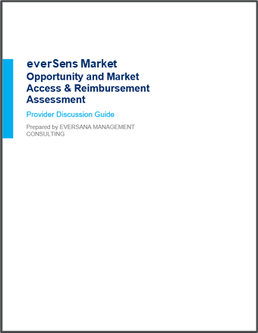


Detailed Project Approach: US Landscape and Foundational Insights Develop NUZ-001 TPPs and Value Proposition
EVERSANA will develop research materials for the KOL, payer and patient/caregiver interviews. These materials will be reviewed and revised in coordination with the Neurizon team.
Primary market research will be conducted by experienced moderators with 100’s of hours of experience and the knowledge on how to accurately probe experts for refined insights.
KOL Research Topics:
Illustrative
Discussion guides and screeners
Perception of clinical unmet needs
Perception of clinical and economic value for NUZ-001
Drivers and barriers of provider choice, including expected impact of payer access restrictions and varying copay levels on prescribing
Expected utilization of NUZ-001
Disease backgrounder and blinded TPPs
Payer Research Topics:
Current access and coverage landscape
Perception of clinical and economic value for NUZ-001
Pricing sensitivity and relationship between price points and coverage
Patient/Caregiver Research Topics:
Perception of clinical value for NUZ-001
Drivers and barriers for product choice
Pricing sensitivity and relationship between price points and utilization

Slide 21
Primary Market Research Approach
Tentative for Discussion
Approach | Methodology | We will follow a mixed methodology (survey and interviews).The research will be double-blinded, and all participants will be screened prior to acceptance Interviews will be conducted over the phone and last roughly 60 minutes for payers and KOLs, and 30 minutes for patients with screen-sharing to share relevant stimuli; the online survey will take approximately 30 minutes to complete on respondents’ own devices.
 | Benefits | Insight into individual stakeholder perspectives based on their priorities and motivations Ability to tailor each conversation to interviewee backgrounds and adjust line of questioning as fielding progresses
Segment | Description* | N |  |  |  | Total N
US Payers | Pharmacy & Medical Directors 3+ years of experience in position Voting P&T member Familiar with ALS and its management Knowledgeable about orphan drug pricing and the impact of pricing on utilization management decisions Payer mix of Commercial and Medicare | National MCOs | Regional MCOs | PBMs | IDNs | 12
 |  | 3-4 | 5-6 | 1-2 | 1-2
US KOLs | [KOL Only] Contribute to or author clinical guidelines or consensus statements in ALS or related neuromuscular diseases [KOL Only] Have peer-reviewed publications in leading journals within the past 5 years [KOL Only] Regularly participate in academic teaching, conference presentations, or advisory boards Board-certified physicians practicing >3 years within their specialty ≥75% of time spent in patient care Mix of geographies and practice affiliations and settings (e.g., academic medical center, IDN, community, private group/solo practice) Experience treating and managing at least 5 ALS patients per month |  |  |  | Interview | 5
Prescribers |  |  |  |  | Survey | 40
Patients/Caregivers | Patients and caregivers of patients who are living with ALS and were diagnosed in the last 6 months Mix of patients who are taking therapy vs. treatment naïve, if possible Mix of geographic locations |  |  |  | Interview | 8
 |  |  |  |  | Survey | No cap (2-week)
*The final screening criteria will be aligned upon in collaboration with the Neurizon core team

